Slide 1
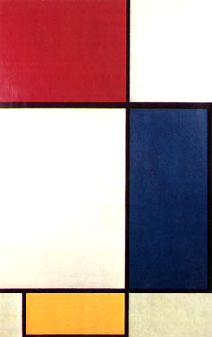
CSE 542 Advanced VLSI Design

Slide 2
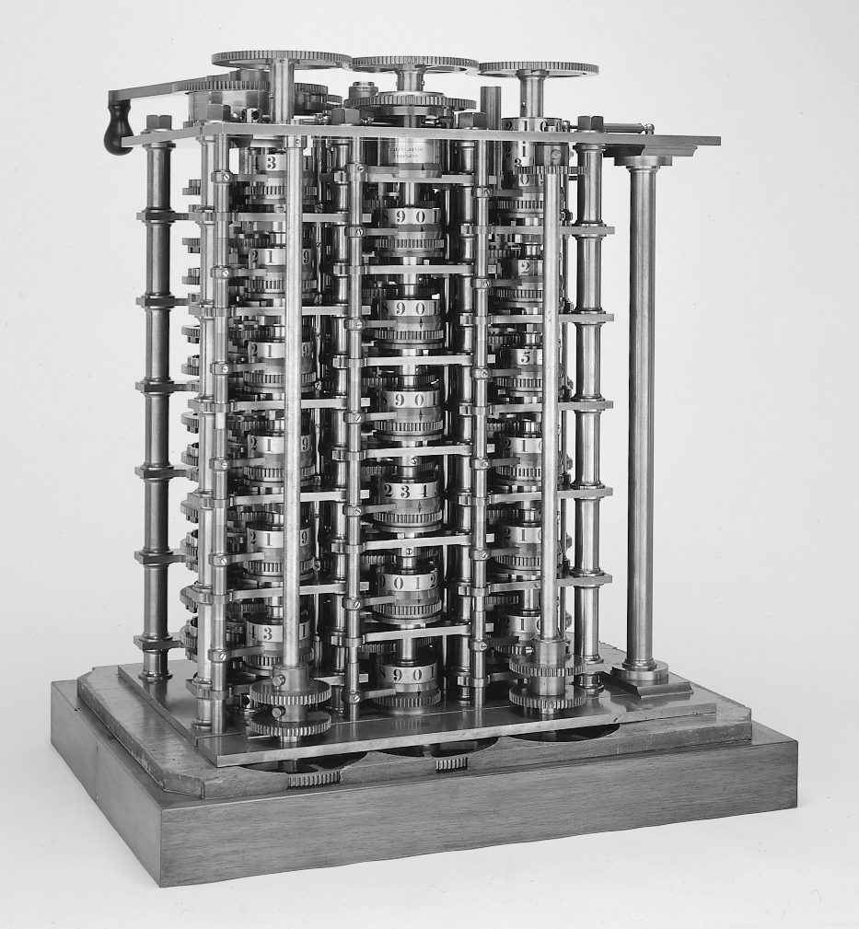
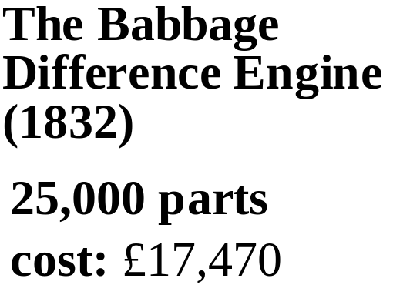
The First Computer

Slide 3
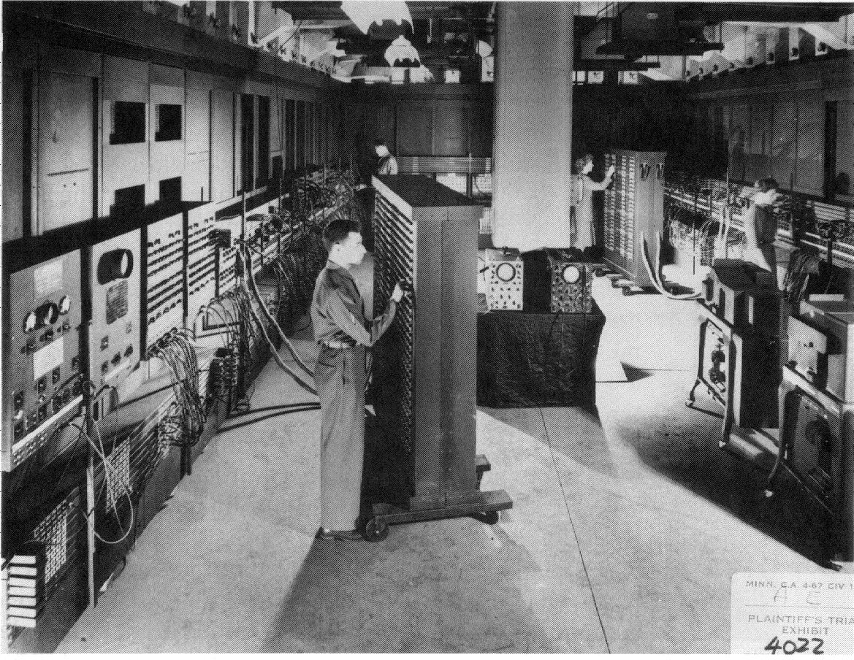
ENIAC - The first electronic computer (1946)

Slide 4
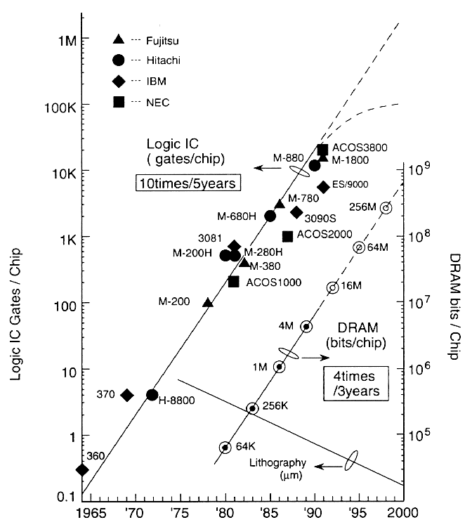
Evolution in Complexity

Slide 5
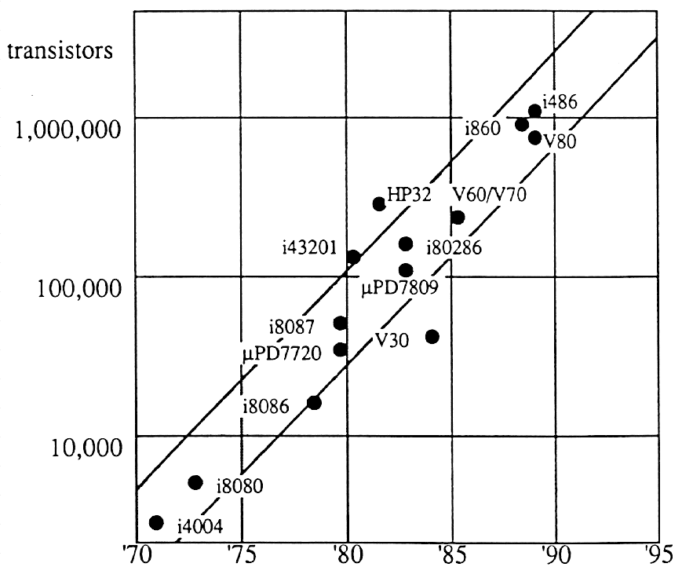
Evolution in Transistor Count

Slide 6
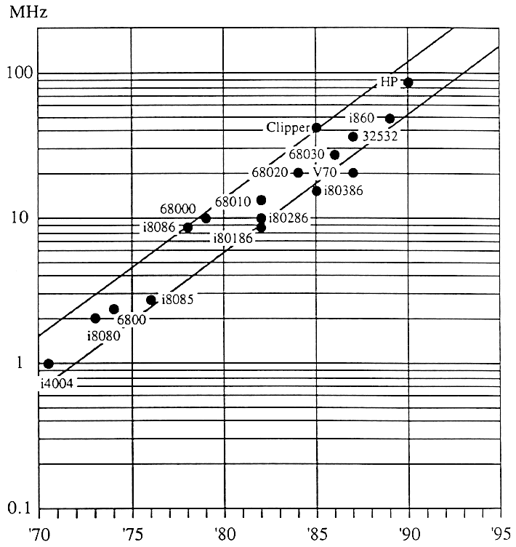
Evolution in Speed/Performance

Slide 7
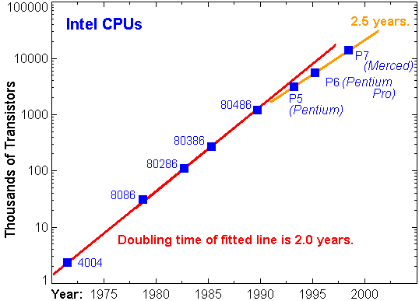
Trends in transistor count

Slide 8
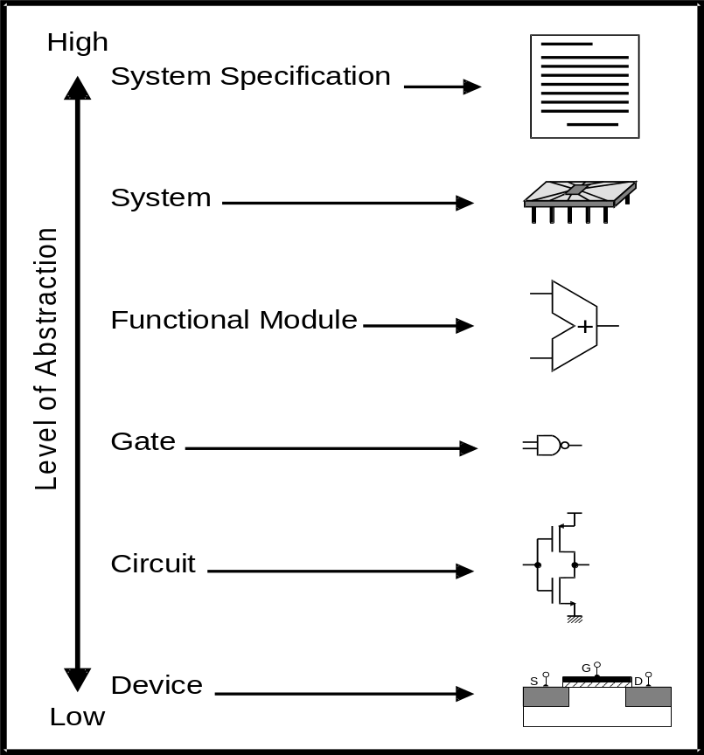
Design abstraction levels

Slide 9
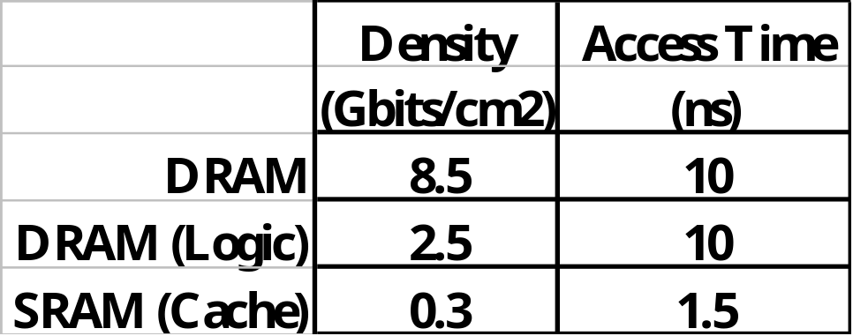
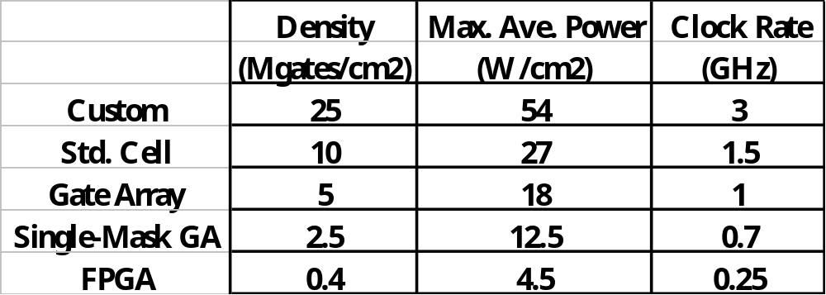
Silicon in 2010
Die Area: 2.5x2.5 cm
Voltage: 0.6 V
Technology: 0.07 μm

Slide 10
Design Abstraction Levels
SYSTEM
MODULE
(Subsystem)
+
GATE
CIRCUIT
DEVICE
G
S
D
n+
n+

Slide 11
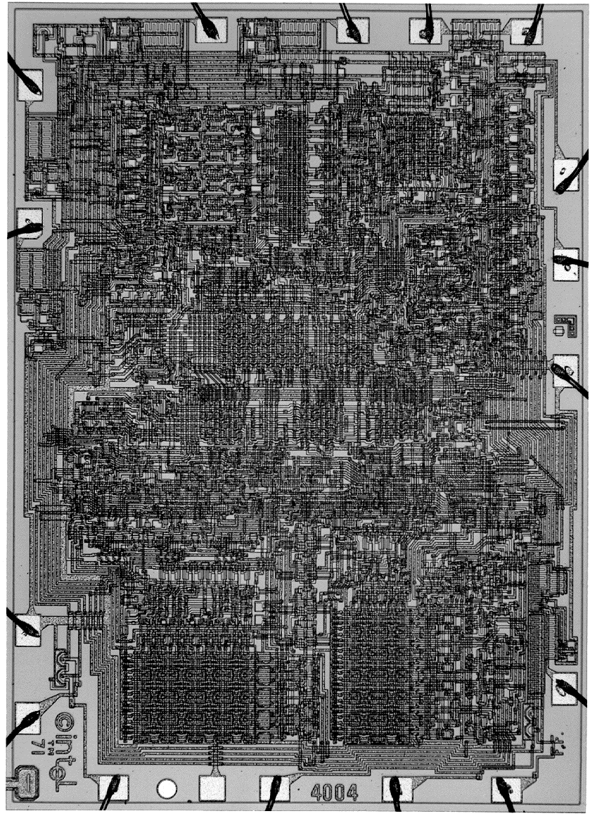
Intel 4004 Micro-Processor

Slide 12
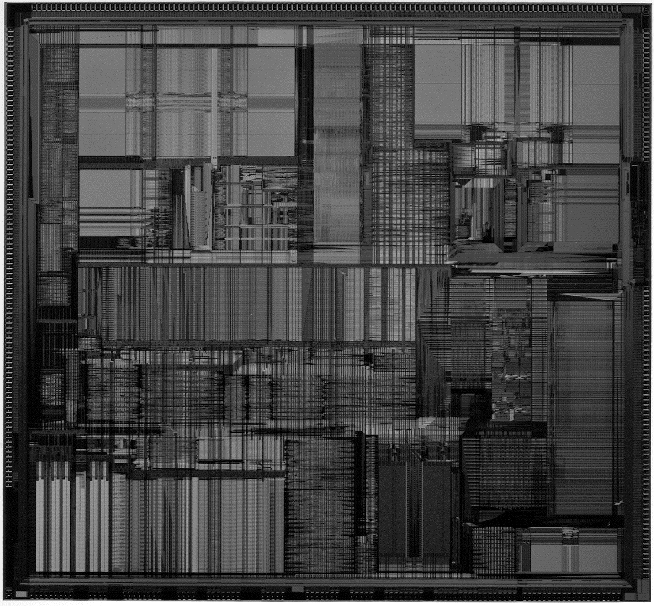
Intel Pentium (II) microprocessor

Slide 13
Design styles
Full custom
Standard cell
Gate-array
Macro-cell
“FPGA”
Combinations

Slide 14
Full custom
Hand drawn geometry
All layers customized
Digital and analog
Simulation at transistor level (analog)
High density
High performance
Long design time

Slide 15
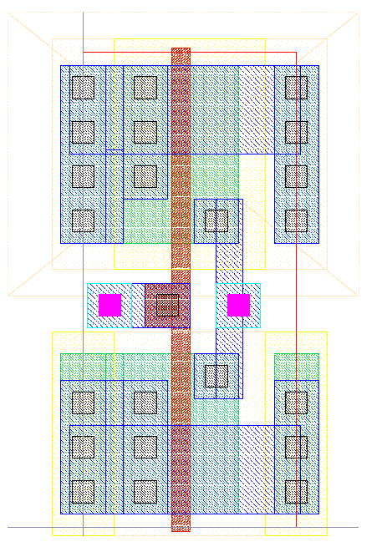
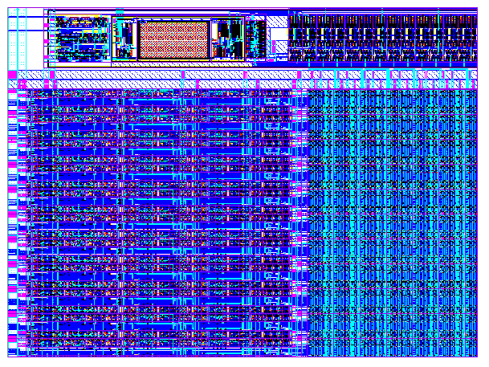
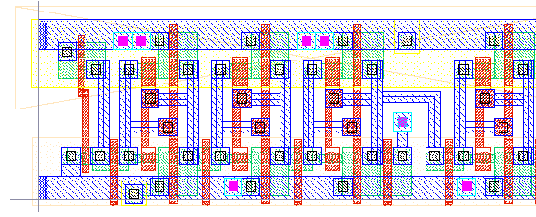
Full custom
Vdd
IN
Out
Gnd

Slide 16
Standard cells
Standard cells organized in rows (and, or, flip-flops,etc.)
Cells made as full custom by vendor (not user).
All layers customized
Digital with possibility of special analog cells.
Simulation at gate level (digital)
Medium density
Medium-high performance
Reasonable design time

Slide 17
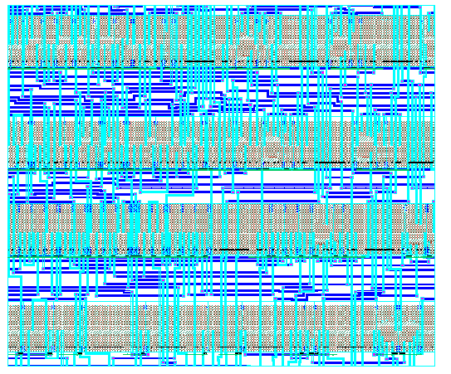
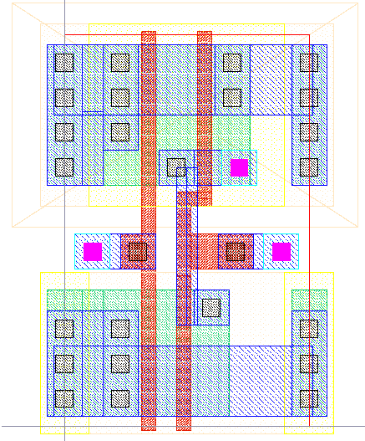
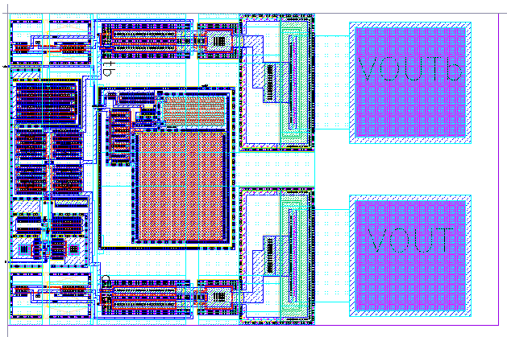
Standard cells
Routing
Cell
IO cell

Slide 18
Gate-array
Predefined transistors connected via metal
Two types: Channel based
Channel less (sea of gates)
Only metallization layers customized
Fixed array sizes (normally 5-10 different)
Digital cells in library (and, or, flip-flops,etc.)
Simulation at gate level (digital)
Medium density
Medium performance
Reasonable design time

Slide 19
Gate-array
Sea of gates
Channel based
Vdd
NAND gate using gate isolation
Vdd
A
B
PMOS
Oxide isolation
A
B
Out
Out
NMOS
Gate isolation
Gnd
Can in principle be used by adjacent cell
Gnd

Slide 20
FPGA = Field Programmable Gate Array
Programmable logic blocks
Programmable connections between logic blocks
No layers customized (standard devices)
Digital only
Low - medium performance (<50 - 100MHz)
Low - medium density (up to ~100k gates)
Programmable by: SRAM, EEROM, Anti_fuse, etc
Cheap design tools on PC’s
Low development cost
High device cost

Slide 21
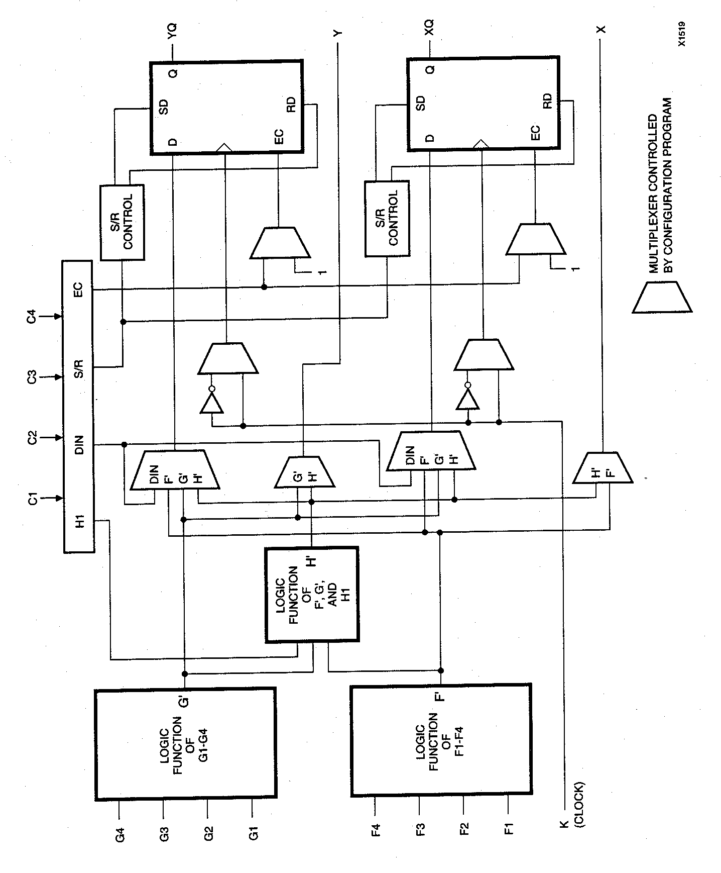
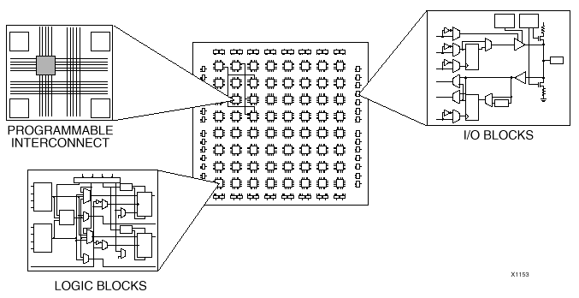
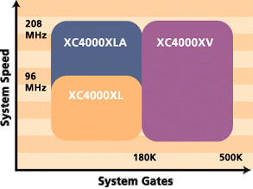
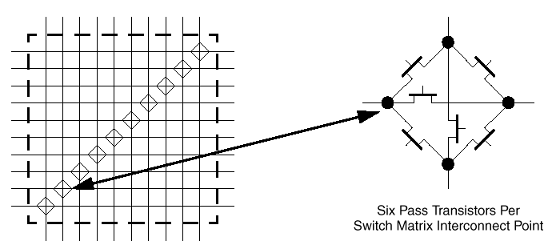
FPGA

Slide 22
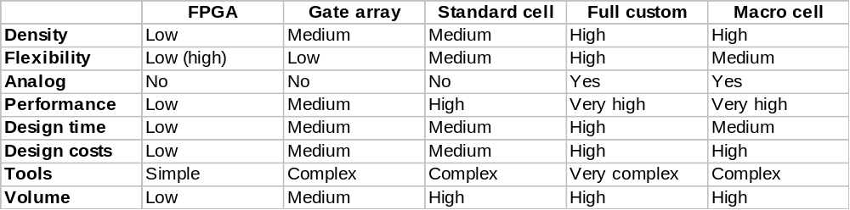
Comparison

